Slide 1


AI-Based Performance Analysis of YOLOv8 for Computer User Health Monitoring: Posture, Drowsiness, and Eye Gaze Detection
New Era University
College of Computer Studies
Rm. 247-B, High School Annex B, New Era University Tel. No.: (+632) 981-4221 loc 3825
E-mail: computerstudies@neu.edu.ph
Researchers:
Celajes, Aeron Red R.
Mallari, Angelo Gerard T.
4BSCS-1

Slide 2
Abstract
New Era University
College of Computer Studies
Rm. 247-B, High School Annex B, New Era University Tel. No.: (+632) 981-4221 loc 3825
E-mail: computerstudies@neu.edu.ph
AI-Based Performance Analysis of YOLOv8 for Computer User Health Monitoring: Posture, Drowsiness, and Eye Gaze Detection

Slide 3
New Era University
College of Computer Studies
Rm. 247-B, High School Annex B, New Era University Tel. No.: (+632) 981-4221 loc 3825
E-mail: computerstudies@neu.edu.ph
Abstract
The proposed paper aims to develop and analyze a multiple AI solution model for computer user health monitoring using YOLOv8 if it is an effective model or not.
The multiple AI solutions for these focuses solely in posture, drowsiness and eye gaze.
The measurement of performance of the model was measured in terms of mean Average Precision (mAP), Precision, and Recall.
The conclusion of this study is that the YOLOv8 is indeed effective as it gives high mAP, precision and recall, hence rejecting the null hypothesis.
AI-Based Performance Analysis of YOLOv8 for Computer User Health Monitoring: Posture, Drowsiness, and Eye Gaze Detection

Slide 4
Introduction
New Era University
College of Computer Studies
Rm. 247-B, High School Annex B, New Era University Tel. No.: (+632) 981-4221 loc 3825
E-mail: computerstudies@neu.edu.ph
AI-Based Performance Analysis of YOLOv8 for Computer User Health Monitoring: Posture, Drowsiness, and Eye Gaze Detection

Slide 5
New Era University
College of Computer Studies
Rm. 247-B, High School Annex B, New Era University Tel. No.: (+632) 981-4221 loc 3825
E-mail: computerstudies@neu.edu.ph
Background of the Study:
Continuous usage of computers can lead to habits such as improper posture, which is one related computer health issue.
Improper posture can cause disturbances in the musculoskeletal balance and may disturb physiological processes other than the musculoskeletal system (Fathima et al., 2024).
Developing a multiple AI solution model that uses YOLOv8 for computer user health monitoring.
The multiple AI solutions for these focuses solely in posture, drowsiness and eye gaze.
AI-Based Performance Analysis of YOLOv8 for Computer User Health Monitoring: Posture, Drowsiness, and Eye Gaze Detection

Slide 6
New Era University
College of Computer Studies
Rm. 247-B, High School Annex B, New Era University Tel. No.: (+632) 981-4221 loc 3825
E-mail: computerstudies@neu.edu.ph
Objectives
The objectives of this study are as follows,
To develop a model that uses YOLOv8 to monitor computer users' posture and detect unhealthy sitting positions.
To develop a model that uses YOLOv8 to identify signs of drowsiness.
To develop a model that uses YOLOv8 to analyze eye gaze patterns, when the eyes are close or not.
To evaluate the effectiveness of the model by its performance using mAP, Precision, and Recall.
AI-Based Performance Analysis of YOLOv8 for Computer User Health Monitoring: Posture, Drowsiness, and Eye Gaze Detection

Slide 7
Literature Review / Studies
New Era University
College of Computer Studies
Rm. 247-B, High School Annex B, New Era University Tel. No.: (+632) 981-4221 loc 3825
E-mail: computerstudies@neu.edu.ph
AI-Based Performance Analysis of YOLOv8 for Computer User Health Monitoring: Posture, Drowsiness, and Eye Gaze Detection

Slide 8
New Era University
College of Computer Studies
Rm. 247-B, High School Annex B, New Era University Tel. No.: (+632) 981-4221 loc 3825
E-mail: computerstudies@neu.edu.ph
Previous Applications of YOLO Models
YOLOv3 was successful in demonstrating for detecting of fruits and other agricultural products with impressive accuracy and speed (Lawal, 2021).
YOLOv4 has introduced afterwards wherein its performance in terms of accuracy and speed was better when it was put into use as a detector that identifies face masks, which will be effective for public health monitoring (Yu & Zhang, 2021).
YOLOv5 further improved, giving greater speed and accuracy than YOLOv4 and YOLOv3, which just continues to improve the model itself as time goes by (Zhang et al., 2022).
YOLOv8 is recently very reliant as it is recently being used in the medical field, where it was used to detect brain tumor and medical imaging (Patel et al., 2024).
AI-Based Performance Analysis of YOLOv8 for Computer User Health Monitoring: Posture, Drowsiness, and Eye Gaze Detection

Slide 9
New Era University
College of Computer Studies
Rm. 247-B, High School Annex B, New Era University Tel. No.: (+632) 981-4221 loc 3825
E-mail: computerstudies@neu.edu.ph
Use in Health Monitoring and Ergonomics
Traditional techniques have been highly based on the self-reported questionnaire or observational study. This kind of approach has often suffered bias from recall and measurement errors (Gao et al., 2021).
Recent approaches have been the use of wearable devices, wherein it gives improved accurate, and objective ways of measuring physical activity and sedentary behavior. (Stefana et al., 2021).
Another approach is by using computer vision wherein a recent study presented on detecting upper body sedentary behaviors with cameras to capture images of the user's posture (Guduru et al., 2021).
AI-Based Performance Analysis of YOLOv8 for Computer User Health Monitoring: Posture, Drowsiness, and Eye Gaze Detection

Slide 10
New Era University
College of Computer Studies
Rm. 247-B, High School Annex B, New Era University Tel. No.: (+632) 981-4221 loc 3825
E-mail: computerstudies@neu.edu.ph
Comparative Analysis of Object Detection Models
Compared to other object detection models like Faster R-CNN and YOLO models, it was compared and results to that YOLO being better in performance making YOLO ideal for real-time applications (Abdulghani & Menekşe Dalveren, 2022).
Then now YOLOv8 improves on its previous models when it comes to balancing of speed and accuracy (Mohan et al., 2024).
AI-Based Performance Analysis of YOLOv8 for Computer User Health Monitoring: Posture, Drowsiness, and Eye Gaze Detection

Slide 11
New Era University
College of Computer Studies
Rm. 247-B, High School Annex B, New Era University Tel. No.: (+632) 981-4221 loc 3825
E-mail: computerstudies@neu.edu.ph
Challenges and Future Directions
The challenges that can occur in object detection are such as customizing the dataset itself considering the variation of pixels, processing of low-resolutions, handling different sizes of multiple objects, the availability of the labeled data, and handling overlapping objects (Diwan et al., 2022).
More datasets can result to better performance of a model.
AI-Based Performance Analysis of YOLOv8 for Computer User Health Monitoring: Posture, Drowsiness, and Eye Gaze Detection

Slide 12
Research Gap or Hypothesis
New Era University
College of Computer Studies
Rm. 247-B, High School Annex B, New Era University Tel. No.: (+632) 981-4221 loc 3825
E-mail: computerstudies@neu.edu.ph
AI-Based Performance Analysis of YOLOv8 for Computer User Health Monitoring: Posture, Drowsiness, and Eye Gaze Detection

Slide 13
New Era University
College of Computer Studies
Rm. 247-B, High School Annex B, New Era University Tel. No.: (+632) 981-4221 loc 3825
E-mail: computerstudies@neu.edu.ph
Research Gap
Limited AI multiple solution models: Current AI models in health monitoring rarely address multiple issues simultaneously.
Focus on single health issues: Recent studies focus on single health concerns, such as posture detection, using tools like IoT and MediaPipe (Sreevani et al., 2024).
Lack of integrated health solutions: A comprehensive model for detecting posture, drowsiness, and disengagement (via eye gaze) is lacking.
AI-Based Performance Analysis of YOLOv8 for Computer User Health Monitoring: Posture, Drowsiness, and Eye Gaze Detection

Slide 14
New Era University
College of Computer Studies
Rm. 247-B, High School Annex B, New Era University Tel. No.: (+632) 981-4221 loc 3825
E-mail: computerstudies@neu.edu.ph
Hypothesis
Null Hypothesis (H₀): YOLOv8 does not effectively detect posture, drowsiness, and eye gaze in computer users with low mAP, precision, and recall, which makes it not a reliable model for computer user health monitoring.
Alternative Hypothesis (H₁): YOLOv8 can effectively detect posture, drowsiness, and eye gaze in computer users with high mAP, precision, and recall, which makes it a reliable model for computer user health monitoring.
AI-Based Performance Analysis of YOLOv8 for Computer User Health Monitoring: Posture, Drowsiness, and Eye Gaze Detection

Slide 15
Methodologies
New Era University
College of Computer Studies
Rm. 247-B, High School Annex B, New Era University Tel. No.: (+632) 981-4221 loc 3825
E-mail: computerstudies@neu.edu.ph
AI-Based Performance Analysis of YOLOv8 for Computer User Health Monitoring: Posture, Drowsiness, and Eye Gaze Detection

Slide 16
New Era University
College of Computer Studies
Rm. 247-B, High School Annex B, New Era University Tel. No.: (+632) 981-4221 loc 3825
E-mail: computerstudies@neu.edu.ph
Dataset Collection
The datasets that were used to train the models are from Roboflow which are already annotated and labeled with its specific class names.
AI-Based Performance Analysis of YOLOv8 for Computer User Health Monitoring: Posture, Drowsiness, and Eye Gaze Detection

Slide 17
New Era University
College of Computer Studies
Rm. 247-B, High School Annex B, New Era University Tel. No.: (+632) 981-4221 loc 3825
E-mail: computerstudies@neu.edu.ph
Dataset Preprocessing and Augmentation
Techniques such as stretching it by 640 x 640 and auto orientation were used before proceeding to the data augmentation.
The techniques used in data augmentation varies per dataset with their specific purposes.
AI-Based Performance Analysis of YOLOv8 for Computer User Health Monitoring: Posture, Drowsiness, and Eye Gaze Detection

Slide 18
New Era University
College of Computer Studies
Rm. 247-B, High School Annex B, New Era University Tel. No.: (+632) 981-4221 loc 3825
E-mail: computerstudies@neu.edu.ph
Model Training
Using YOLOv8, the researchers trained their models with the annotated and labeled datasets.
YOLOv8 is known for its reliability lately than other newer YOLO models such as YOLOv9 and YOLOv11
AI-Based Performance Analysis of YOLOv8 for Computer User Health Monitoring: Posture, Drowsiness, and Eye Gaze Detection

Slide 19
New Era University
College of Computer Studies
Rm. 247-B, High School Annex B, New Era University Tel. No.: (+632) 981-4221 loc 3825
E-mail: computerstudies@neu.edu.ph
Evaluation Metrics
The models were evaluated using metrics such as mAP/mAP50, precision, and recall.
For more deeper insights of the model’s performance, the researchers used additional metrics such as mAP50-95, Confusion Matrix, F1-Score, Box loss, Classification loss, and Distribution Focal loss
AI-Based Performance Analysis of YOLOv8 for Computer User Health Monitoring: Posture, Drowsiness, and Eye Gaze Detection

Slide 20
New Era University
College of Computer Studies
Rm. 247-B, High School Annex B, New Era University Tel. No.: (+632) 981-4221 loc 3825
E-mail: computerstudies@neu.edu.ph
Data Splitting
By dividing it into three separate parts: training data, validation data, and test data, we can be sure that the model doesn’t just use the same datasets for training.
AI-Based Performance Analysis of YOLOv8 for Computer User Health Monitoring: Posture, Drowsiness, and Eye Gaze Detection

Slide 21
Results and Discussions
New Era University
College of Computer Studies
Rm. 247-B, High School Annex B, New Era University Tel. No.: (+632) 981-4221 loc 3825
E-mail: computerstudies@neu.edu.ph
AI-Based Performance Analysis of YOLOv8 for Computer User Health Monitoring: Posture, Drowsiness, and Eye Gaze Detection

Slide 22
Posture Model Metrics
New Era University
College of Computer Studies
Rm. 247-B, High School Annex B, New Era University Tel. No.: (+632) 981-4221 loc 3825
E-mail: computerstudies@neu.edu.ph
AI-Based Performance Analysis of YOLOv8 for Computer User Health Monitoring: Posture, Drowsiness, and Eye Gaze Detection

Slide 23
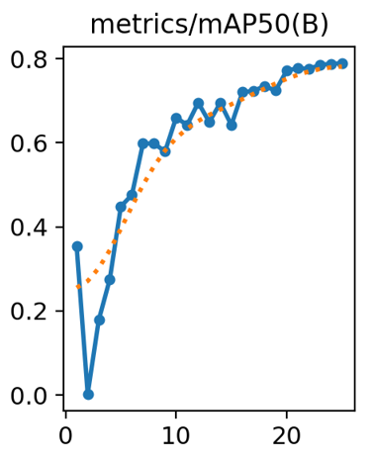
New Era University
College of Computer Studies
Rm. 247-B, High School Annex B, New Era University Tel. No.: (+632) 981-4221 loc 3825
E-mail: computerstudies@neu.edu.ph
mAP50 for Posture
mAP50 epoch 1 ≈ 0.35424 or 35.4%
mAP50 epoch 24 ≈ 0.78798 or 78.8% (optimal)
mAP50 epoch 25 ≈ 0.789 or 78.9%
This improvement indicates the model’s enhanced ability to accurately localize and classify objects with moderate performance sustaining within the final epochs.
Figure 1: mAP50 - Confidence Curve for Posture
AI-Based Performance Analysis of YOLOv8 for Computer User Health Monitoring: Posture, Drowsiness, and Eye Gaze Detection

Slide 24
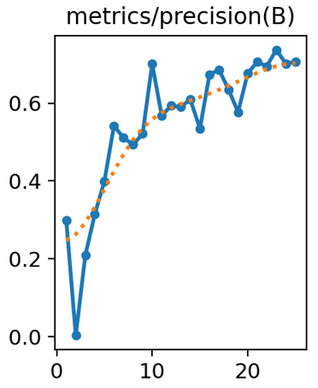
New Era University
College of Computer Studies
Rm. 247-B, High School Annex B, New Era University Tel. No.: (+632) 981-4221 loc 3825
E-mail: computerstudies@neu.edu.ph
Precision for Posture
Precision epoch 1 ≈ 0.29952 or 30.0%
Precision epoch 24 ≈ 0.70137 or 70.1% (optimal)
Precision epoch 25 ≈ 0.70614 or 70.6%
This indicates that as the training progresses, the model becomes better at identifying correct posture classes, but it could have an improvement to have a higher precision overall.
Figure 2: Precision for Posture
AI-Based Performance Analysis of YOLOv8 for Computer User Health Monitoring: Posture, Drowsiness, and Eye Gaze Detection

Slide 25
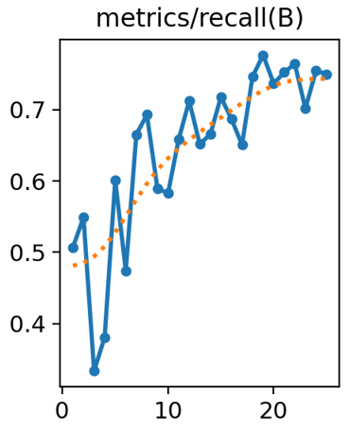
New Era University
College of Computer Studies
Rm. 247-B, High School Annex B, New Era University Tel. No.: (+632) 981-4221 loc 3825
E-mail: computerstudies@neu.edu.ph
Recall for Posture
Recall epoch 1 ≈ 0.50708 or 50.7%
Recall epoch 24 ≈ 0.75461 or 75.5% (optimal)
Recall epoch 25 ≈ 0.7502 or 75.0%
This implies that the model improves at capturing relevant instances as training goes on, but improvements can be done as it may still be able to achieve a higher overall recall.
Figure 3: Recall for Posture
AI-Based Performance Analysis of YOLOv8 for Computer User Health Monitoring: Posture, Drowsiness, and Eye Gaze Detection

Slide 26
Drowsiness Model Metrics
New Era University
College of Computer Studies
Rm. 247-B, High School Annex B, New Era University Tel. No.: (+632) 981-4221 loc 3825
E-mail: computerstudies@neu.edu.ph
AI-Based Performance Analysis of YOLOv8 for Computer User Health Monitoring: Posture, Drowsiness, and Eye Gaze Detection

Slide 27
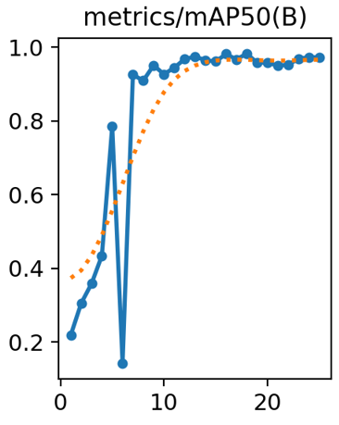
New Era University
College of Computer Studies
Rm. 247-B, High School Annex B, New Era University Tel. No.: (+632) 981-4221 loc 3825
E-mail: computerstudies@neu.edu.ph
mAP50 for Drowsiness
mAP50 epoch 1 ≈ 0.21902 or 21.9%
mAP50 epoch 25 ≈ 0.97229 or 97.2% (optimal)
This improvement indicates the model’s enhanced ability to accurately localize and classify objects with high performance sustaining within the final epochs.
Figure 4: mAP50 for Drowsiness
AI-Based Performance Analysis of YOLOv8 for Computer User Health Monitoring: Posture, Drowsiness, and Eye Gaze Detection

Slide 28
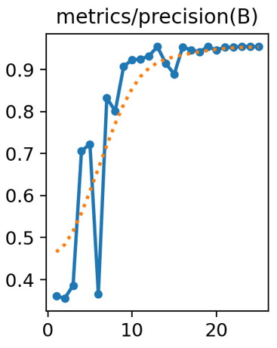
New Era University
College of Computer Studies
Rm. 247-B, High School Annex B, New Era University Tel. No.: (+632) 981-4221 loc 3825
E-mail: computerstudies@neu.edu.ph
Precision for Drowsiness
Precision epoch 1 ≈ 0.36134 or 36.1%
Precision epoch 25 ≈ 0.95448 or 95.4% (optimal)
This indicates that as the training progresses, the model becomes better at identifying the correct drowsy class, wherein this model is highly effective at it.
Figure 5: Precision for Drowsiness
AI-Based Performance Analysis of YOLOv8 for Computer User Health Monitoring: Posture, Drowsiness, and Eye Gaze Detection

Slide 29
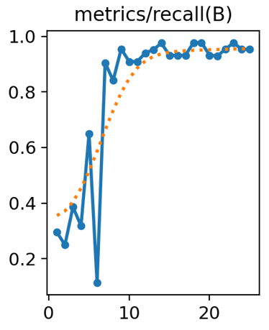
New Era University
College of Computer Studies
Rm. 247-B, High School Annex B, New Era University Tel. No.: (+632) 981-4221 loc 3825
E-mail: computerstudies@neu.edu.ph
Recall for Drowsiness
Recall epoch 1 ≈ 0.29545 or 29.5%
Recall epoch 25 ≈ 0.9532 or 95.3% (optimal)
This implies that the model has a high effective ability in capturing relevant instances as it even improves as training goes on.
Figure 6: Recall for Drowsiness
AI-Based Performance Analysis of YOLOv8 for Computer User Health Monitoring: Posture, Drowsiness, and Eye Gaze Detection

Slide 30
Eye Gaze Model Metrics
New Era University
College of Computer Studies
Rm. 247-B, High School Annex B, New Era University Tel. No.: (+632) 981-4221 loc 3825
E-mail: computerstudies@neu.edu.ph
AI-Based Performance Analysis of YOLOv8 for Computer User Health Monitoring: Posture, Drowsiness, and Eye Gaze Detection

Slide 31
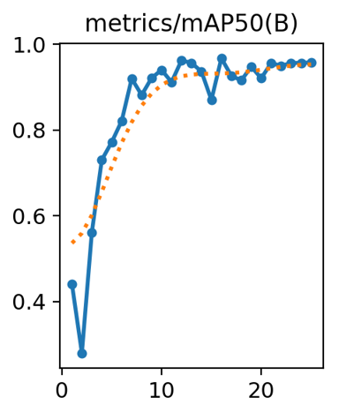
New Era University
College of Computer Studies
Rm. 247-B, High School Annex B, New Era University Tel. No.: (+632) 981-4221 loc 3825
E-mail: computerstudies@neu.edu.ph
mAP50 for Eye Gaze
mAP50 epoch 1 ≈ 0.44136 or 44.1%
map50 epoch 22 ≈ 0.9496 or 95.0% (optimal)
mAP50 epoch 25 ≈ 0.95751 or 95.8%
This improvement indicates the model’s enhanced ability to accurately localize and classify objects with high performance sustaining within the final epochs.
Figure 7: mAP50 for Eye Gaze
AI-Based Performance Analysis of YOLOv8 for Computer User Health Monitoring: Posture, Drowsiness, and Eye Gaze Detection

Slide 32
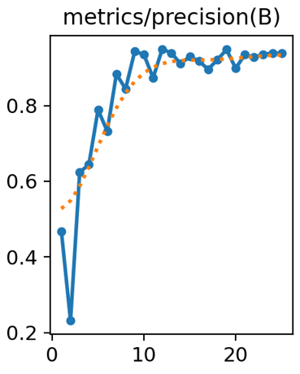
New Era University
College of Computer Studies
Rm. 247-B, High School Annex B, New Era University Tel. No.: (+632) 981-4221 loc 3825
E-mail: computerstudies@neu.edu.ph
Precision for Eye Gaze
Precision epoch 1 ≈ 0.46839 or 46.8%
Precision epoch 22 ≈ 0.9274 or 92.7% (optimal)
Precision epoch 25 ≈ 0.95751 or 95.8%
This depicts that as training goes on, the model improves its ability to recognize the appropriate eye gaze class, which makes the model effective in doing the task.
Figure 8: Precision for Eye Gaze
AI-Based Performance Analysis of YOLOv8 for Computer User Health Monitoring: Posture, Drowsiness, and Eye Gaze Detection

Slide 33
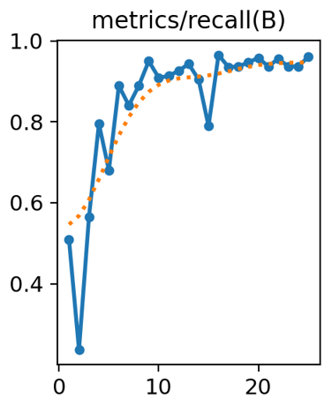
New Era University
College of Computer Studies
Rm. 247-B, High School Annex B, New Era University Tel. No.: (+632) 981-4221 loc 3825
E-mail: computerstudies@neu.edu.ph
Recall for Eye Gaze
Recall epoch 1 ≈ 0.50877 or 50.9%
Recall epoch 22 ≈ 0.95586 or 95.6% (optimal)
Recall epoch 25 ≈ 0.96053 or 96.1%
Given that it even gets better with training, this suggests that the model has a high effective ability to capture relevant instances.
Figure 9: Recall for Eye Gaze
AI-Based Performance Analysis of YOLOv8 for Computer User Health Monitoring: Posture, Drowsiness, and Eye Gaze Detection

Slide 34
Conclusion
New Era University
College of Computer Studies
Rm. 247-B, High School Annex B, New Era University Tel. No.: (+632) 981-4221 loc 3825
E-mail: computerstudies@neu.edu.ph
AI-Based Performance Analysis of YOLOv8 for Computer User Health Monitoring: Posture, Drowsiness, and Eye Gaze Detection

Slide 35
New Era University
College of Computer Studies
Rm. 247-B, High School Annex B, New Era University Tel. No.: (+632) 981-4221 loc 3825
E-mail: computerstudies@neu.edu.ph
Conclusion
This research aimed to develop and evaluate an object detection model using the YOLOv8 architecture to accurately identify and classify health related issues of computer users. The researchers used 3 models and combined it into one for deployment, and the study concludes that the YOLOv8 is effective for computer user health monitoring, which therefore rejects the null hypothesis. This study can help in assisting computer users to keep their health in check and avoid any issues concerning their well-being.
AI-Based Performance Analysis of YOLOv8 for Computer User Health Monitoring: Posture, Drowsiness, and Eye Gaze Detection

Slide 36
Model Results
New Era University
College of Computer Studies
Rm. 247-B, High School Annex B, New Era University Tel. No.: (+632) 981-4221 loc 3825
E-mail: computerstudies@neu.edu.ph
AI-Based Performance Analysis of YOLOv8 for Computer User Health Monitoring: Posture, Drowsiness, and Eye Gaze Detection

Slide 37



New Era University
College of Computer Studies
Rm. 247-B, High School Annex B, New Era University Tel. No.: (+632) 981-4221 loc 3825
E-mail: computerstudies@neu.edu.ph
Posture Detection Model
Drowsiness Detection Model
Eye Gaze Detection Model
Figure 10: Model Results from Roboflow
AI-Based Performance Analysis of YOLOv8 for Computer User Health Monitoring: Posture, Drowsiness, and Eye Gaze Detection

Slide 38
References
New Era University
College of Computer Studies
Rm. 247-B, High School Annex B, New Era University Tel. No.: (+632) 981-4221 loc 3825
E-mail: computerstudies@neu.edu.ph
AI-Based Performance Analysis of YOLOv8 for Computer User Health Monitoring: Posture, Drowsiness, and Eye Gaze Detection

Slide 39
New Era University
College of Computer Studies
Rm. 247-B, High School Annex B, New Era University Tel. No.: (+632) 981-4221 loc 3825
E-mail: computerstudies@neu.edu.ph
[1] Abdulghani, A. M. A., & Menekşe Dalveren, G. G. (2022). Moving Object Detection in Video with Algorithms YOLO and Faster R-CNN in Different Conditions. Avrupa Bilim Ve Teknoloji Dergisi(33), 40-54. https://doi.org/10.31590/ejosat.1013049
[2] Armecin Workspace. (n.d.). improper-sitting Object Detection Dataset. Roboflow. https://universe.roboflow.com/armecin-workspace/improper-sitting-av8w4
[3] Augmented Startups (2022, December). Drowsiness detection object detection dataset and Pre-Trained model by augmented startups. Roboflow. https://universe.roboflow.com/augmented-startups/drowsiness-detection-cntmz
[4] Diwan, T., Anirudh, G. & Tembhurne, J.V. (2023). Object detection using YOLO: challenges, architectural successors, datasets and applications. Multimed Tools Appl 82, 9243–9275 . https://doi.org/10.1007/s11042-022-13644-y
AI-Based Performance Analysis of YOLOv8 for Computer User Health Monitoring: Posture, Drowsiness, and Eye Gaze Detection

Slide 40
New Era University
College of Computer Studies
Rm. 247-B, High School Annex B, New Era University Tel. No.: (+632) 981-4221 loc 3825
E-mail: computerstudies@neu.edu.ph
[5] Fathima, D., Lobo, J., Angioi, M., Blach, W., Rydzik, L., Ambroży, T. & Malliaropoulos, N. (2024, August 09). Sedentary Lifestyle, Heart Rate Variability, and the Influence on Spine Posture in Adults: A Systematic Review Study. Appl. Sci. 2024, 14(16), 6985. https://doi.org/10.3390/app14166985
[6] Gao, Z., Liu, W., McDonough, D. J., Zeng, N., & Lee, J. E. (2021). The Dilemma of Analyzing Physical Activity and Sedentary Behavior with Wrist Accelerometer Data: Challenges and Opportunities. Journal of Clinical Medicine, 10(24), 5951. https://doi.org/10.3390/jcm10245951
[7] Guduru, R. K. R., Domeika, A., Dubosiene, M., & Kazlauskiene, K. (2021). Prediction framework for upper body sedentary working behaviour by using deep learning and machine learning techniques. Soft Computing, 26, 12969–12984. https://doi.org/10.1007/s00500-021-06156-8
[8] Lawal, M.O. Tomato detection based on modified YOLOv3 framework. Sci Rep 11, 1447 (2021). https://doi.org/10.1038/s41598-021-81216-5
AI-Based Performance Analysis of YOLOv8 for Computer User Health Monitoring: Posture, Drowsiness, and Eye Gaze Detection

Slide 41
New Era University
College of Computer Studies
Rm. 247-B, High School Annex B, New Era University Tel. No.: (+632) 981-4221 loc 3825
E-mail: computerstudies@neu.edu.ph
9] Mohan, M., Ali, L., Muhammed Swavaf, Salah Bouktif, Munkhjargal Gochoo, Hamad Aljassmi, & Alnajjar, F. (2024). Navigating the YOLO Landscape: A Comparative Study of Object Detection Models for Emotion Recognition. IEEE Access, 12, 109427–109442. https://doi.org/10.1109/access.2024.3439346
[10] Omura, J. D., Whitfield, G. P., Chen, T. J., Hyde, E. T., Ussery, E. N., Watson, K. B., & Carlson, S. A. (2021). Surveillance of Physical Activity and Sedentary Behavior Among Youth and Adults in the United States: History and Opportunities. Journal of Physical Activity and Health, 18(S1), S6-S24. https://doi.org/10.1123/jpah.2021-0179
[11] Patel, S., Kadam, Y., Thombare, A., Salvi, K., Jadhav, D. (2024). A review of brain tumor detection techniques using yolov8. International Journal for Research in Applied Science and Engineering Technology, 12(3), 1075-1078. https://doi.org/10.22214/ijraset.2024.58666
[12] Redmon, J., Divvala, S., Girshick, R., & Farhadi, A. (2016). You Only Look Once: Unified, RealTime Object Detection. In Proceedings of the IEEE Conference on Computer Vision and Pattern Recognition (CVPR). https://doi.org/10.48550/arXiv.1506.02640
AI-Based Performance Analysis of YOLOv8 for Computer User Health Monitoring: Posture, Drowsiness, and Eye Gaze Detection

Slide 42
New Era University
College of Computer Studies
Rm. 247-B, High School Annex B, New Era University Tel. No.: (+632) 981-4221 loc 3825
E-mail: computerstudies@neu.edu.ph
[13] Solimani, F., Cardellicchio, A., Dimauro, G., Petrozza, A., Summerer, S., Cellini, F., & Renò, V. (2024, March). Optimizing tomato plant phenotyping detection: Boosting YOLOv8 architecture to tackle data complexity. Computers and Electronics in Agriculture, 218, 108728. https://doi.org/10.1016/j.compag.2024.108728
[14] Sreevani, V., Reddy, B. S., Nithin, K., Vardhan, K. H., Mohammed, K. A., Reddy, U., Lakhanpal, S., & Kalra, R. (2024). Advanced interdisciplinary approaches for bad posture detection using computer vision and IoT, E3S Web of Conferences, 507, 01045. https://doi.org/10.1051/e3sconf/202450701045
[15] Stefana, E., Marciano, F., Rossi, D., Cocca, P., & Tomasoni, G. (2021). Wearable Devices for Ergonomics: A Systematic Literature Review. Sensors, 21(3), 777. https://doi.org/10.3390/s21030777
[16] Yolo. (n.d.). sleep1 Object Detection Dataset and Pre-Trained Model. Roboflow. https://universe.roboflow.com/yolo-i9xsa/sleep1
AI-Based Performance Analysis of YOLOv8 for Computer User Health Monitoring: Posture, Drowsiness, and Eye Gaze Detection

Slide 43
New Era University
College of Computer Studies
Rm. 247-B, High School Annex B, New Era University Tel. No.: (+632) 981-4221 loc 3825
E-mail: computerstudies@neu.edu.ph
[17] Yu, J., & Zhang, W. (2021). Face Mask Wearing Detection Algorithm Based on Improved YOLO-v4. Sensors, 21(9), 3263. https://doi.org/10.3390/s21093263
[18] Zhang, Y., Guo, Z., Wu, J., Tian, Y., Tang, H., & Guo, X. (2022). Real-Time Vehicle Detection Based on Improved YOLO v5. Sustainability, 14(19), 12274. https://doi.org/10.3390/su141912274
AI-Based Performance Analysis of YOLOv8 for Computer User Health Monitoring: Posture, Drowsiness, and Eye Gaze Detection

